Slide 1
Year 10 PreATAR Science
Introduction and Planning Investigations

Slide 2
Learning Intentions
Get to know each other
Discuss expectations
Discuss assessment outline
Review experiment design

Slide 3
Success criteria
Write a hypothesis for investigation
Use variables to plan an investigation that is accurate, valid and reliable
Identify different types of data

Slide 4
My name is…

Slide 5
Expectations
Respect
Responsibility
Tolerance

Slide 6
Programme and Assessment

Slide 7
Homework, Study and Assignments

Slide 8
Study tools
Glossary
Formula and equations

Slide 9






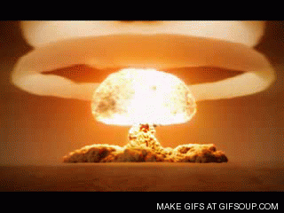
Planning
You need to consider
accuracy
reliability
validity

Slide 10
You will need to think about
Appropriate equipment
Pretesting
Repeat trials
Replicates
Sample size
Safety or ethical hazards

Slide 11
Variables
I
D
C

Slide 12
Writing a good hypothesis
If…then…
Relates variables
Not “will affect”, what effect?
If I increase…then…will increase/decrease/stay the same.

Slide 13
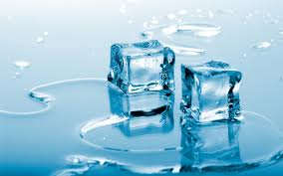
IDC then write as a hypothesis
1. Do larger iceblocks melt slower?

Slide 14
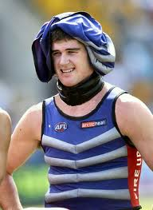
2. Do ice vests improve footy players recovery?

Slide 15
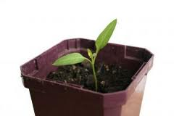
3. Do plants grow better in brighter lights?

Slide 16
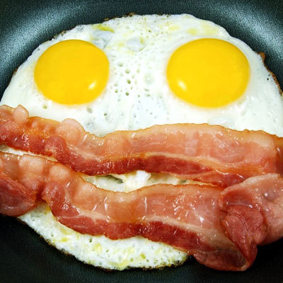
4. Do kids who eat breakfast do better at school?

Slide 17
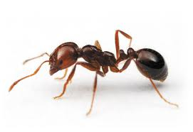
5. Are ants more active in hot weather?

Slide 18
Types of independent variables
Numerical vs. non-numerical
Continuous, discrete or grouped
This affects the type of hypothesis and the type of graph
The type of graph determines what you can use it for

Slide 19
Why is continuous numerical data best?
Line graphs
Interpolation
Extrapolation

Slide 20
Success criteria
Write a hypothesis for investigation
Use variables to plan an investigation that is accurate, valid and reliable
Identify different types of data

